Slide 1
PREPARED BY UNM-Taos multimedia services

Slide 2
UNM-Taos Directory
2018

Slide 3
Overview
The 2 directories
Using the 2 directories
Updating the 2 directories

Slide 4
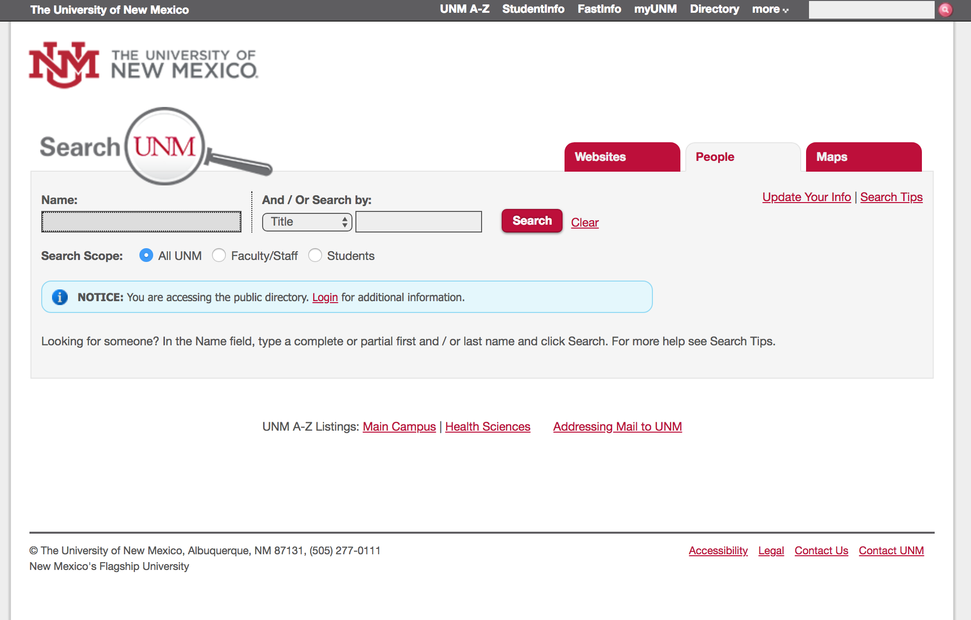
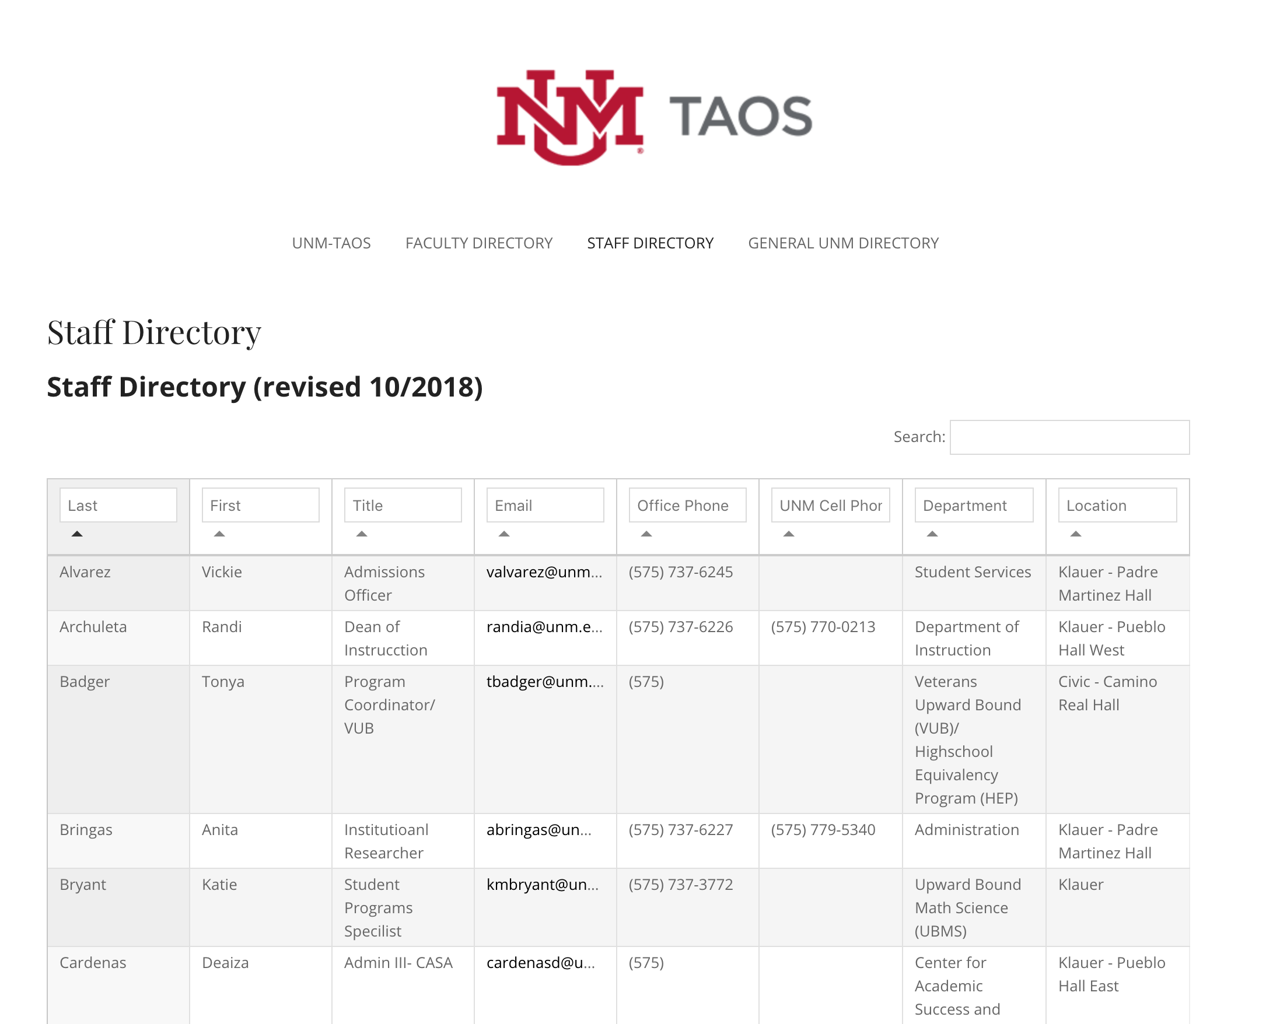
2 Directories
DirecTory.unm.edu
Taos.unm.edu/directory

Slide 5
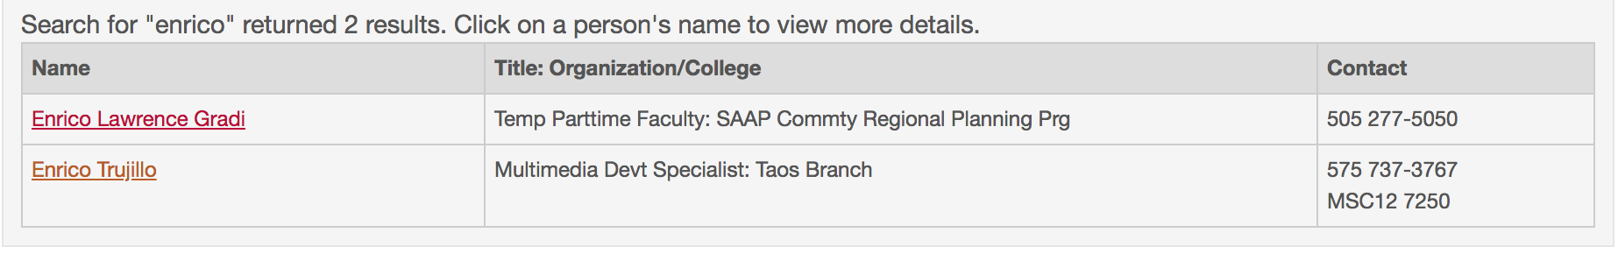
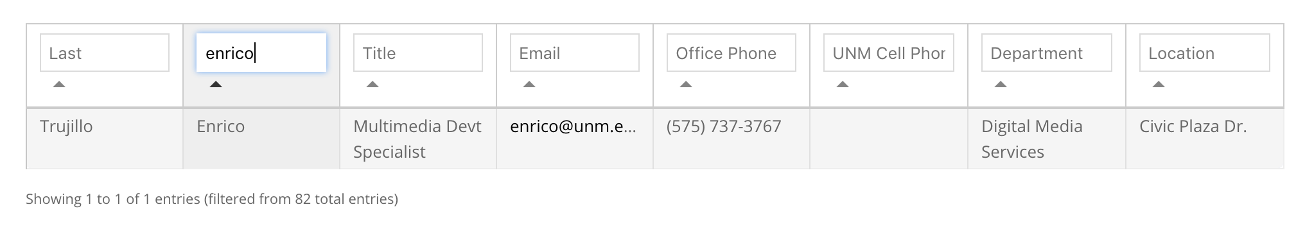
Using the 2 Directories
DirecTory.unm.edu
Taos.unm.edu/directory

Slide 6
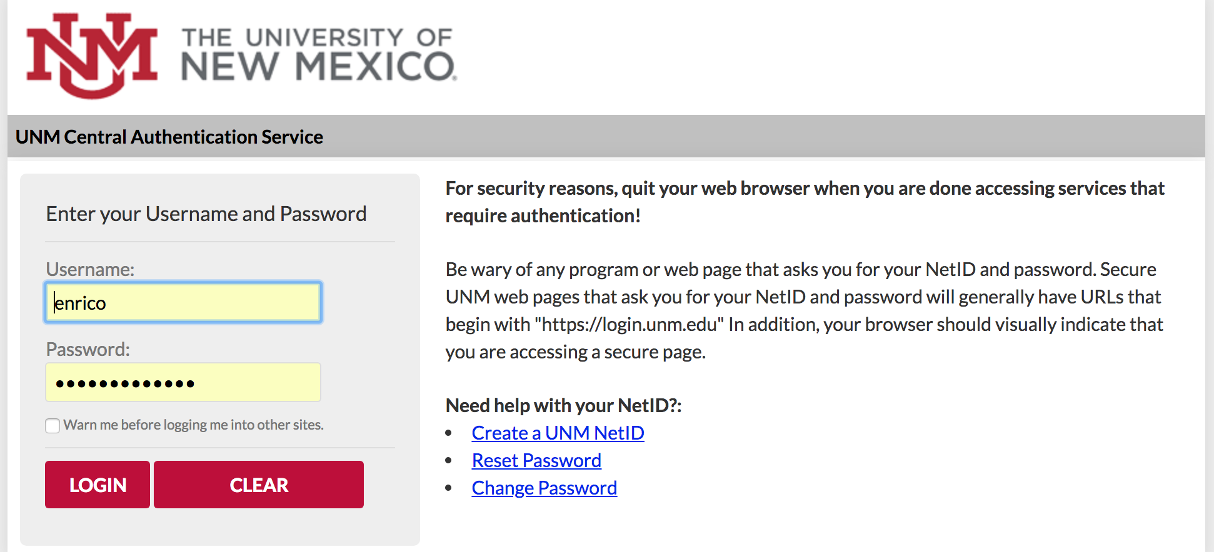
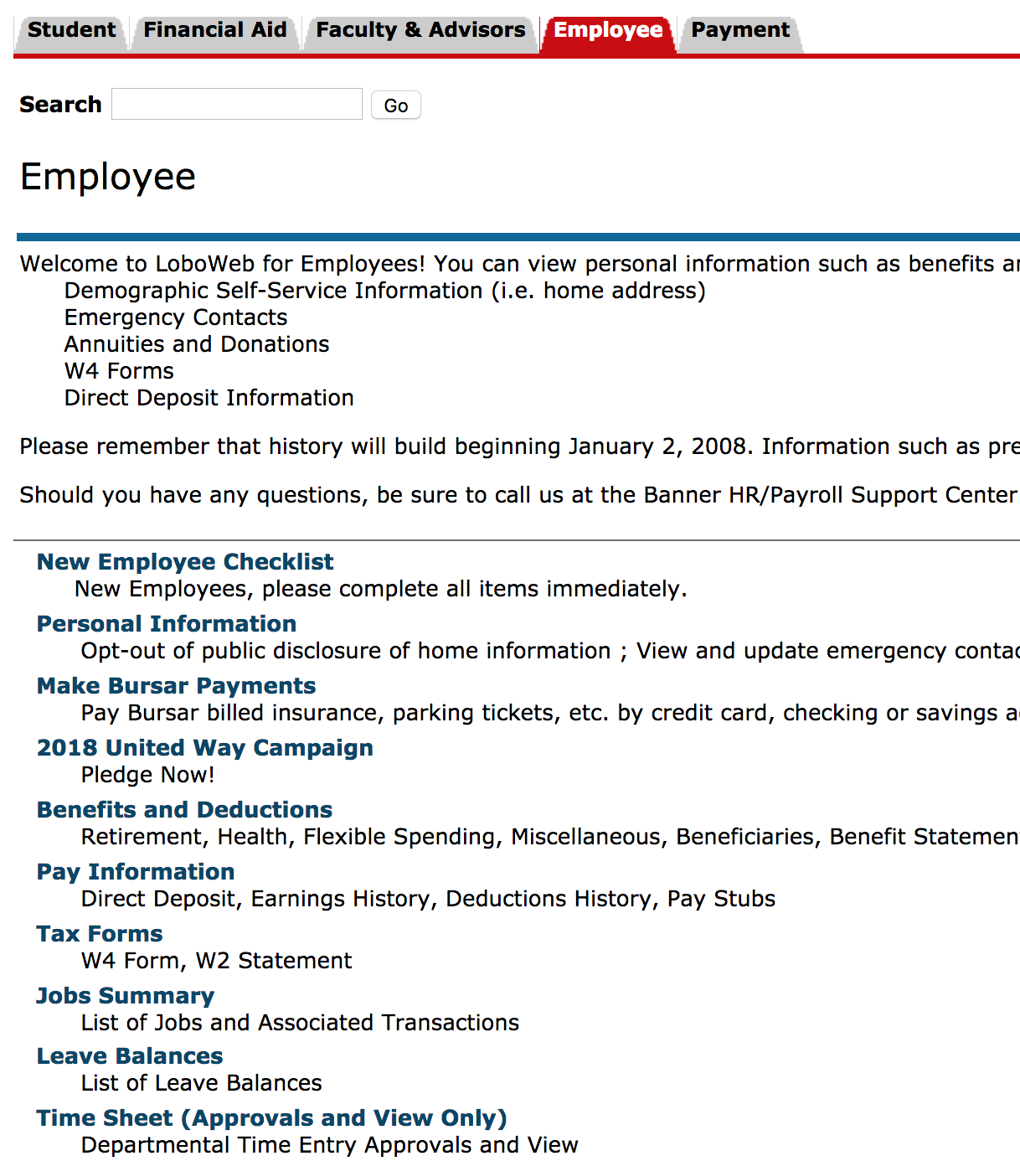
Updating Directory.unm.edu
dssmain.unm.edu
Demographic Self Service

Slide 7
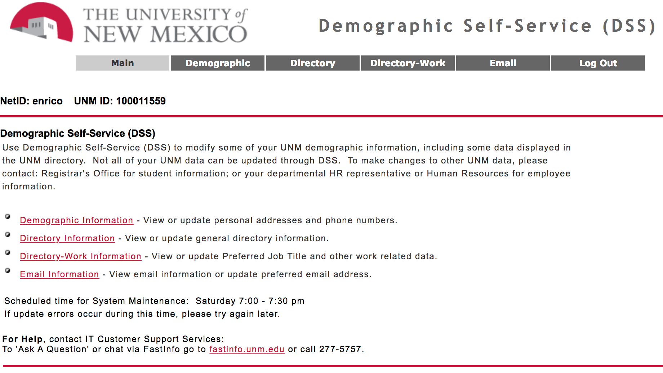
Updating Directory.unm.edu
Demographic Self Service

Slide 8
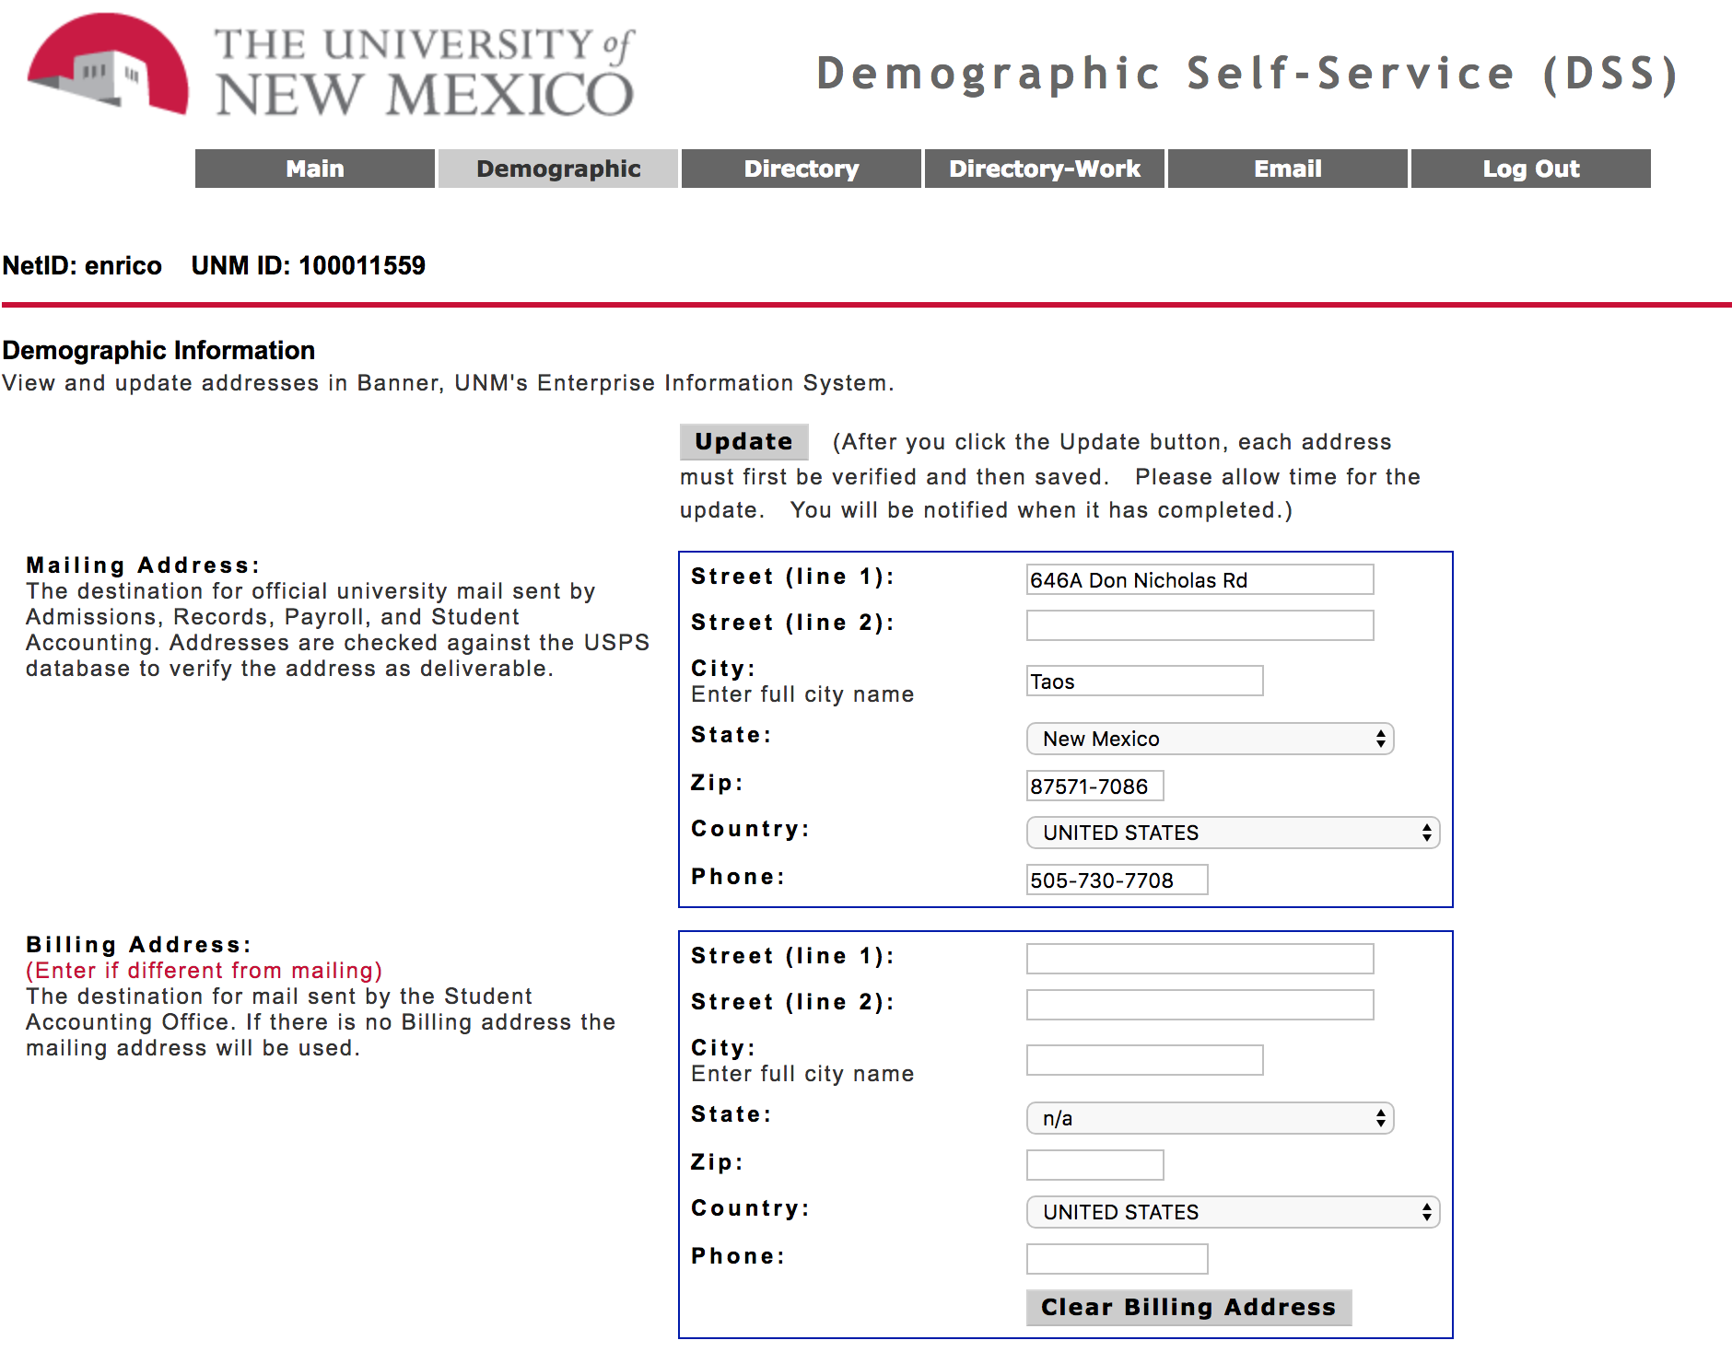
Updating Directory.unm.edu
Demographic Self Service

Slide 9
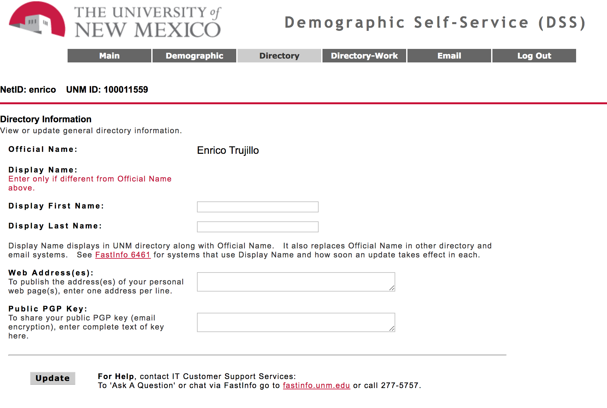
Updating Directory.unm.edu
Demographic Self Service

Slide 10
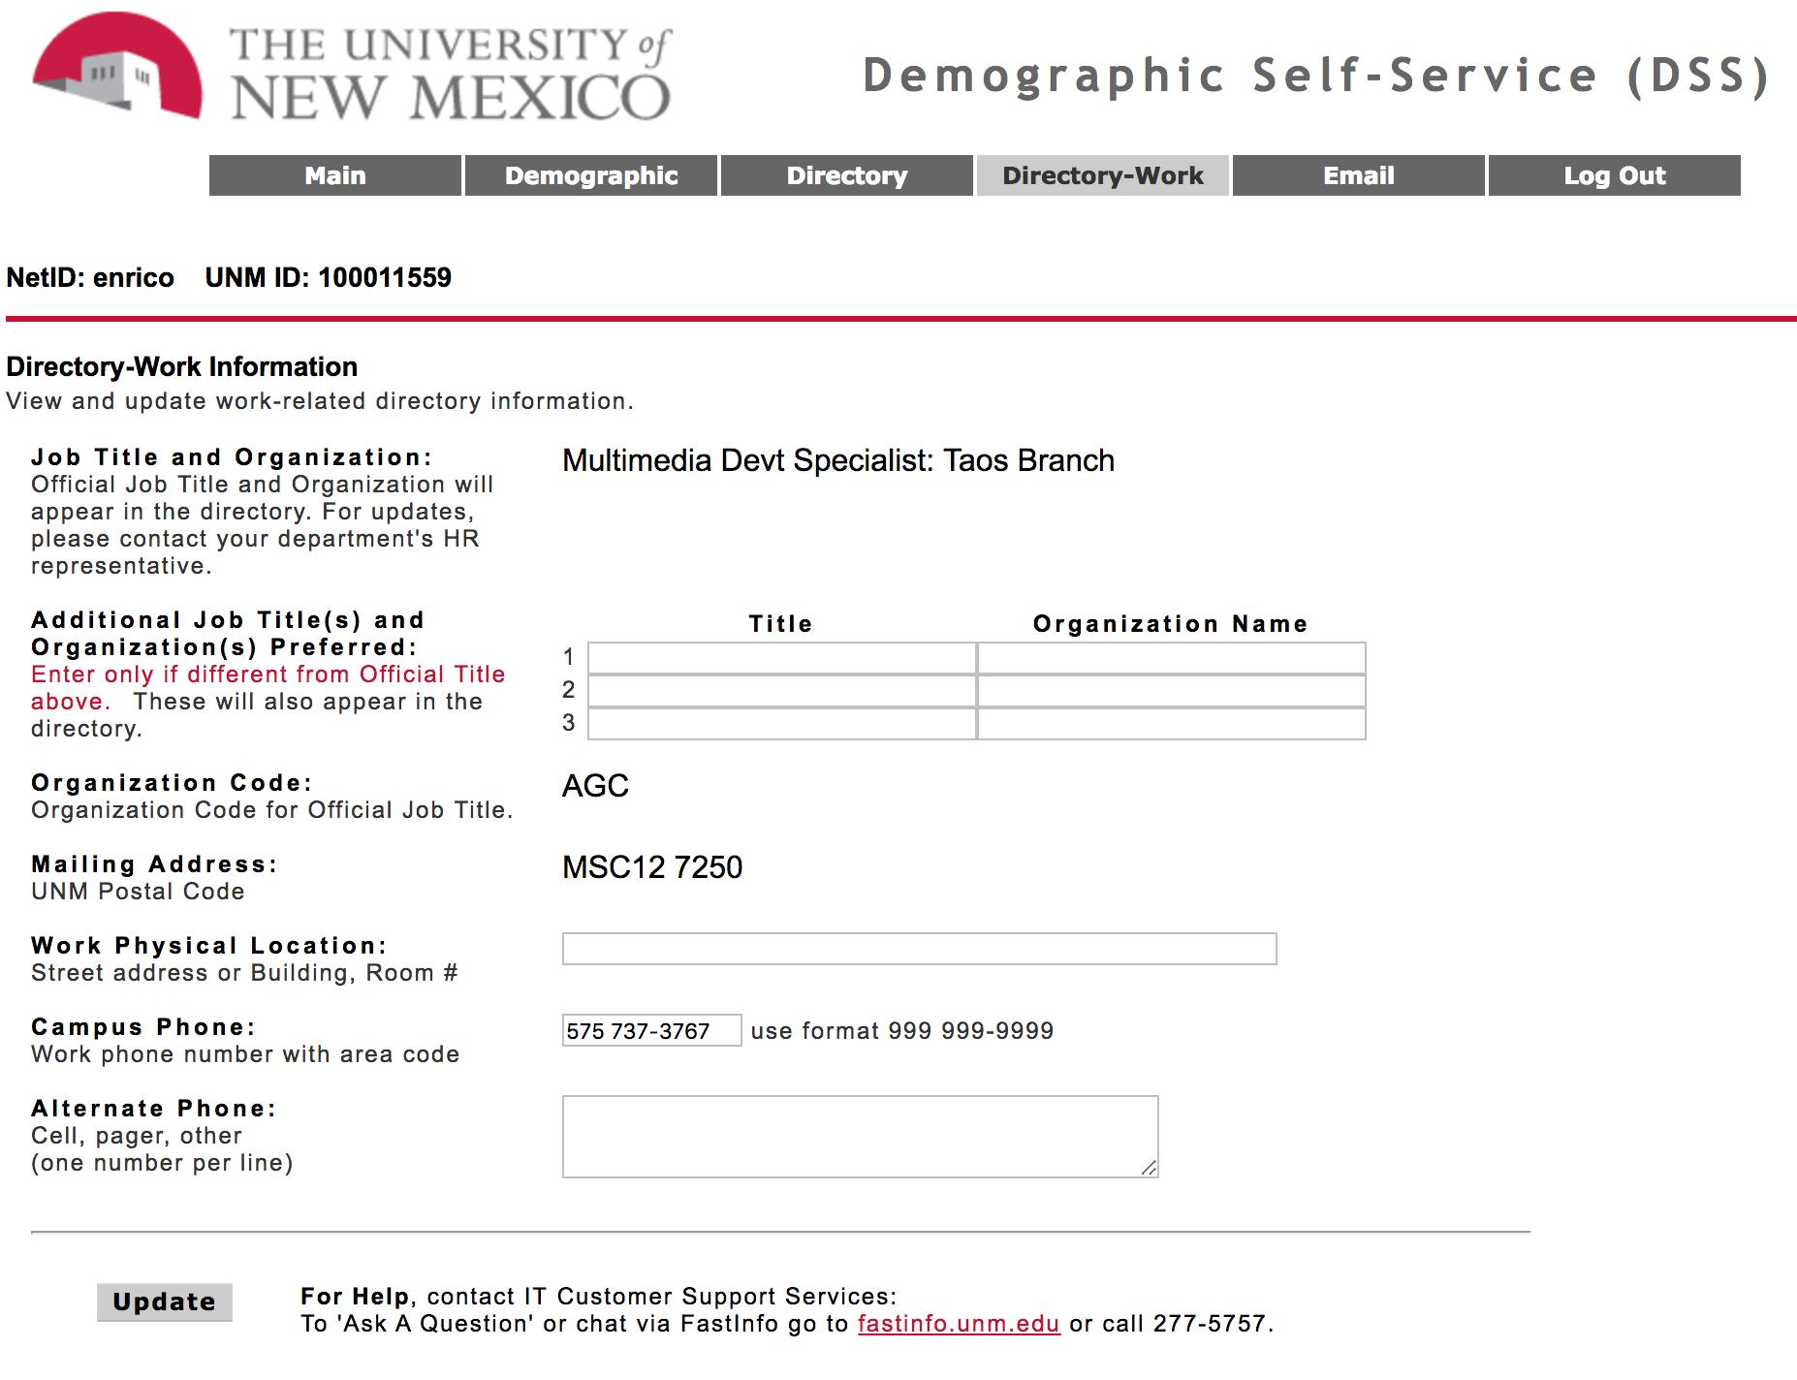
Updating Directory.unm.edu
Demographic Self Service

Slide 11
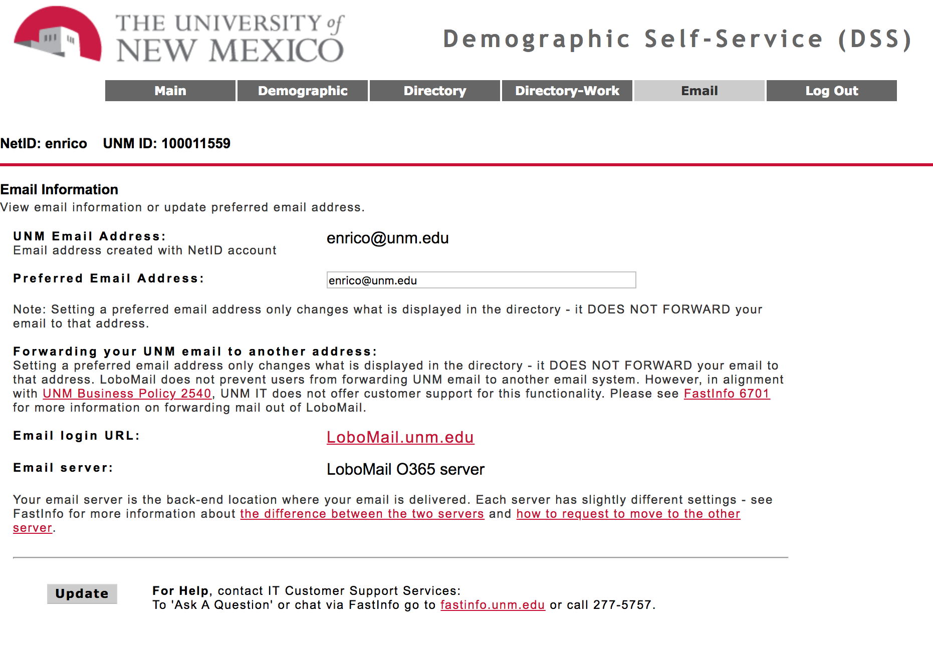
Updating Directory.unm.edu
Demographic Self Service

Slide 12
Updating Taos Directory

